Slide 1

Generating Text-based Adventure Games
Anna Orosz
A Thesis in Data Science
for the Degree of Master of Science in Engineering at the University of Pennsylvania
December 20th, 2021

Slide 2
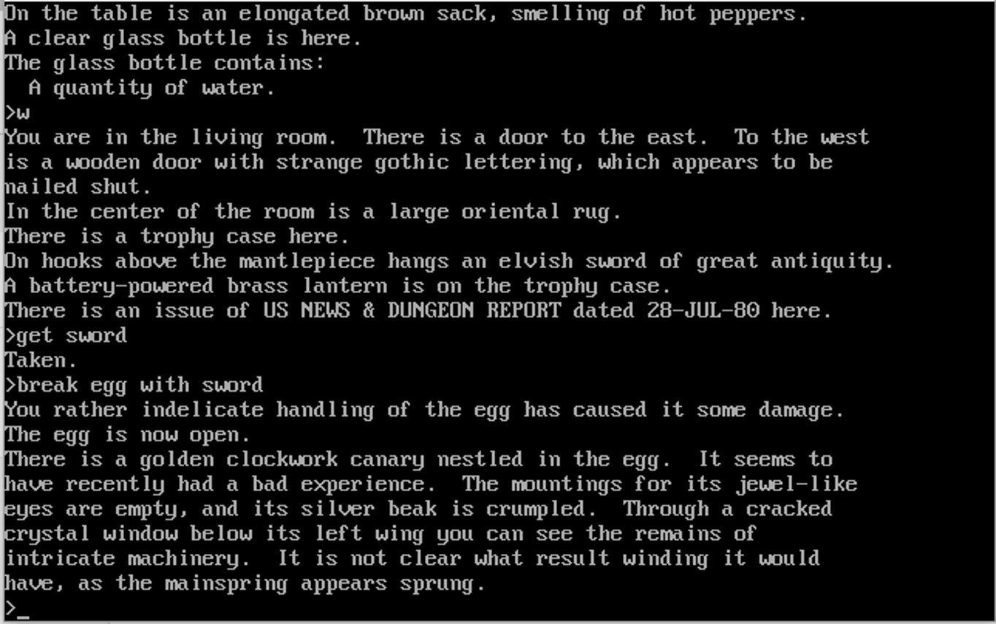

What is a text-
based
adventure game?

Slide 3
A conversation from 30 years ago…
From: goetz@acsu.buffalo.edu (Phil Goetz) Subject: Re: Adventure generators
Date: 29 Oct 92 04:40:05 GMT From: morpheus@sage.cc.purdue.edu (Morpheus Nosferatu) Subject: Adventure generators
Has anyone ever worked on, or even heard of, an adventure generator? I'm not talking about an adventure design language like TADS or Alan, but rather a stand-alone adventure generator that produces complete adventures, where the user need only give a minimal degree of input, such as the level of complexity, type of adventure (mystery, treasure hunt, etc.), size of adventure, and so forth? ... But as anyone ever heard of someone trying to come up with a generator whigh would produce infocom-style text adventures? I can just imagine what kind of limitations it would have, but I'm curious to know if anyone has tried this, and if so what degree of success they've had.
No. ... The generator you speak of is not written, not being written, and not anywhere on the horizon. In 50 years, maybe. In 20, definitely not. The problem of writing interesting stories, which adhere to someone's definition of a plot (with goal explanations, conflict, resolution, comlication, climax, etc., all occuring at appropriate intervals) is very hard, and I don't expect a solution soon. But the problem of writing clever puzzles involves much greater creativity, and I have seen NO evidence that ANYBODY has a clue in these creativity issues; the most you will find in the field are a few vague theories of creativity. This problem is what Stuart Shapiro calls "AI-complete": Solving it would be equivalent to solving all the other problems of AI.
Phil

Slide 4
Goals
What makes a good text-adventure game?
How to generate game-appropriate text?
What is the most cost- and time-efficient method to implement for such auto-generation of Text-adventure games?
How to evaluate the generated text and attributes?

Slide 5
The data - Facebook LIGHT data
The paper
Intended for generating conversational data
Provides great background for fictional text generation
Data used
Extensive library that included dictionaries of:
Objects
Characters
Rooms/categories
Wide range of attributes

Slide 6
The model
GPT-3
Most advanced & largest language model yet
175 billion parameters
Built by OpenAI
Fine-tuning
re-training a pre-trained LM using custom data
weights of the LM are updated for the characteristics of the data and the specific task
Few-shot learning
we train a model on some classes and predict for a new class - model has only seen a handful examples

Slide 7
Generating Descriptions

Slide 8
Statistics about # of examples in objects, rooms, characters
Update model parameters to fit the task of generating descriptions
Generating object/room/character descriptions with fine-tuned model
Data analysis
Train/Dev/ Test
Fine-tuning
Few-shot learning
Text generation
Split data:
80% train (fine-tuning)
10% dev (few-shot learning)
10% test (generating descriptions)
Give model a handful of examples to generate text in desired format

Slide 9
 | Original | Davinci | Curie | Curie w/ few-shot learning | Babbage
 | Once a fairly profitable farm, the Old Queen Farm is now a deteriorated old shack surrounded by uninhabitable fields with soil incapable of growing even weeds. The farm house shows signs that is being occupied by wild animals, and the roof is beginning to cave inwards. | The Old Queen Farm is a dilapidated farmhouse with a tiny little garden. It has a barn and stables for animals. It has a long driveway and meadow behind it. The farm has been vacant for over a year, but the grass hasn't grown in the meadow or by the house or by the barn or stables, because of some magic that keeps it from growing. The house is empty but perfectly clean, because it's being maintained by magic. | The old queen farm is a large, grassy field that is surrounded by several oak trees. There are two large, open barns on opposite sides of the field. The old wooden fence is beginning to show signs of age and wear. | This farm has been in the family for many generations and is very well known. The farm is enormous, stretching as far as the eye can see. It's barns are huge and full of every imaginable animal, and there are wagons with supplies coming and going all day. The fields are green with growing crops and cows grazing. There is a huge castle in the distance, but it seems to be out of place here. | This farm is the oldest one in the kingdom. It's run by the queen and her butler, a former soldier who has been transformed into a servant. The queen and her new assistant, the butler, are constantly arguing about what to do with it.
1 - 5 | 4.4 | 4.6 | 4 | 4.4 | 3.8
The Old Queen Farm
rating

Slide 10
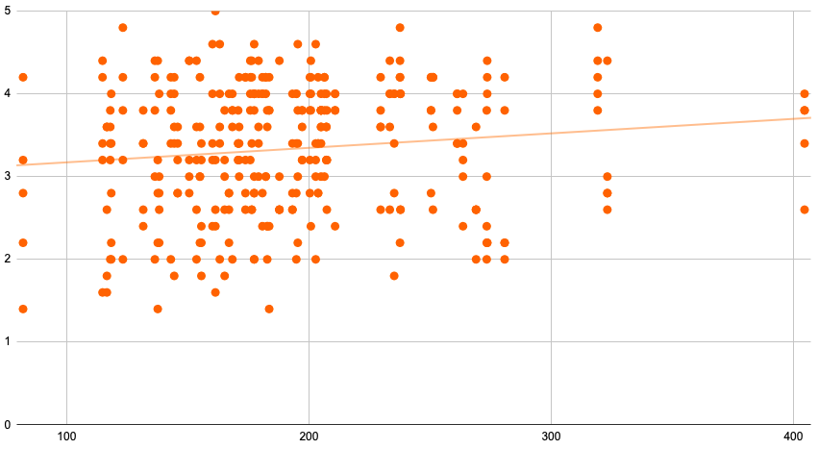
Does length of text
predict
rating?

Slide 11
Generating Item Attributes

Slide 12
A closer look at ‘object’ data
{'base_form': ['sword', 'Sword'],
'desc_entries': 2,
'descriptions': ['The sword is very old, you would assume it had once belonged to a legendary warrior.',
"The sword's legend is known by everyone, it is famous throughout the land."],
'ex_room_ids': [],
'holding_character_ids': [],
'in_room_ids': [12],
'is_container': 0.0,
'is_drink': 0.0,
'is_food': 0.0,
'is_gettable': 1.0,
'is_plural': 1.0,
'is_surface': 0.0,
'is_weapon': 1.0,
'is_wearable': 0.0,
'link_entries': 1,
'name': 'Legendary swords',
'object_id': 1188}
‘Objects’ dataset has a myriad of attributes:
mostly binary attributes
Used two different engines (Curie+Davinci) to test performance
Compared natural vs non-natural language during training

Slide 13
Let’s look at the results
Question: Does Davinci or Curie predict object attributes better?
Question: How important is it that the prompt is in natural language?
Predicting ‘food’ attribute, in %
metric | Curie | Davinci | Baseline
precision | 3.25 | 2.63 | 0.0
recall | 80 | 80 | N/A
accuracy | 48.28 | 26.96 | 41.6
Predicting ‘weapon’ attribute, in %
metric | natural | non-natural | baseline
precision | 3.25 | 2.63 | 0.0
recall | 80 | 80 | N/A
accuracy | 48.28 | 26.96 | 94.83
Answer: cost-to-value is better for Curie overall
Answer: much better performance w/ natural language

Slide 14
Conclusion and Future work
Fine-tuning is a powerful tool that allows less-powerful models (Curie) to be as effective as any (Davinci)
Few-shot learning performs well in case of small trainingset -> need to be careful about class imbalance!
GPT-3 performs best with natural language
Future work: analyse performance using more metrics

Slide 15
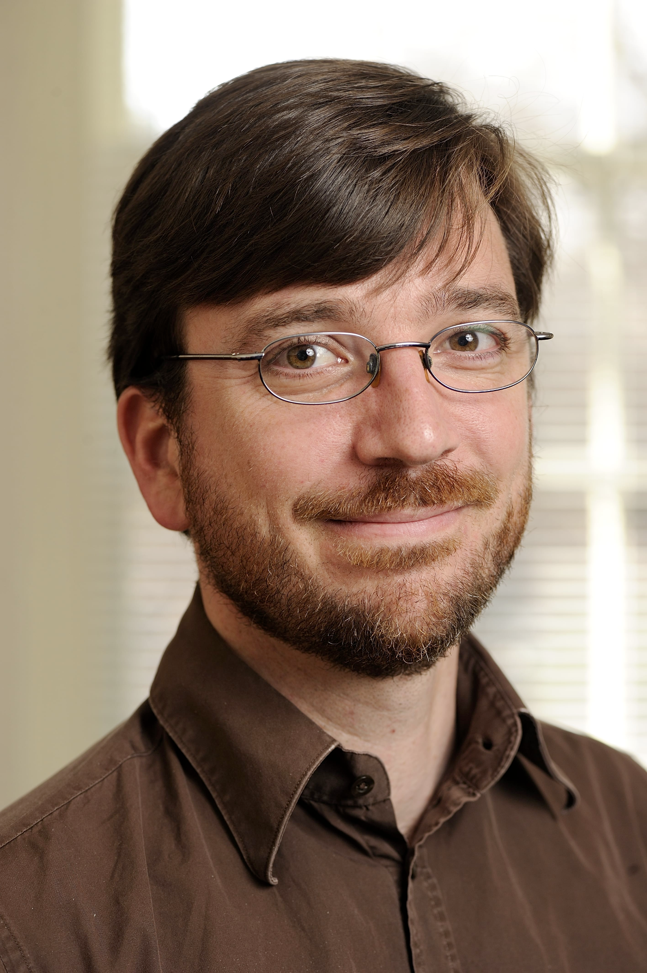

Special thanks to my advisors, without whom this work would not have been possible:
Professor Chris Callison-Burch
Lara Martin, PhD

Slide 16
Q+A

